Slide 1
Software Quality Management
By
Dr. Junaid Akram
Assistant Professor at Department Of Computer Science Comsats (Lahore)

Slide 2
Software Quality Assurance
Process
Definition &
Standards
Formal
Technical
Reviews
Analysis
&
Reporting
Test
Planning
& Review
Measurement

Slide 3
Software Quality Management
Concerned with ensuring the required level of quality is achieved in a software product
Involves the definition of appropriate quality standards and the definition of procedures to ensure that these standards are followed
Works best when a ‘quality culture’ is created where quality if seen as everyone’s responsibility

Slide 4
Quality Definition
Quality means that a product satisfies the demands of its specifications
It also means achieving a high level of customer satisfaction with the product
In software systems this is difficult
customer quality requirements (e.g. efficiency or reliability) often conflict with developer quality requirements (e.g. maintainability or reusability)
software specifications are often incomplete, inconsistent, or ambiguous

Slide 5
Quality Management Activities
Quality assurance
establishing organizational quality standards and procedures
Quality planning
selecting and modifying applicable quality standards and procedures for a particular project
Quality control
ensuring quality standards and procedures are followed by development team
Note: Quality management should be separated from project management to ensure independence.

Slide 6
ISO 9000
International set of standards for quality management
Quality standards and procedures must be documented in an organizational quality manual
An external body is often used to certify that the quality manual conforms to ISO 9000 standards
Many customers are demanding that suppliers are ISO 9000 certified

Slide 7
ISO 9000 and quality management

Slide 8
Quality Standards
Key to effective quality management
Product standards define the characteristics exhibited by all components (e.g. programming style issues)
Process standards describe how a software process is to be implemented

Slide 9
Document Standards
Document identification standards
how documents are labeled
Document structure standards
organization of project documents
Document presentation standards
fonts, styles, logos, etc.
Document update standards
change control and version definition

Slide 10
Software Quality Attributes
Safety
Security
Reliability
Resilience
Robustness
Understandability
Testability
Adaptability
Modularity
Complexity
Portability
Usability
Accessibility
Reusability
Efficiency
Learnability

Slide 11
Quality Control
Examines the software development process to ensure that all relevant procedures and standards are being followed
Two basic approaches
quality reviews
software measurement and assessment

Slide 12
Quality Reviews
Group of knowledgeable people examines a software component and its documentation
Code, design models, specifications, test plans, standards, etc. can be subjected to review

Slide 13
Review Purposes
Quality function
part of the general quality management process
Project management function
provide information to project managers
Training and communication function
product knowledge is shared among development team members

Slide 14
Software Metric
Any type of measurement that relates to a software system, process, or document
LOC, person-months, function points
Metrics allow for the quantification of the software or a software process
May be used to predict product attributes or to control the software process

Slide 15
Static Metrics
Fan-in
number of functions that call a particular function
Fan-out
number of functions called by a particular function
Length of code
size of program (LOC or KLOC)
Complexity
measures control complexity inside program
Fog index
average word and sentence lengths in documents

Slide 16
Characteristics of good Software
A software product is concluded as a good software by what it offers and how well it can be used.
The factors that decide the software properties are divided into three categories: Operational, Transitional, and Maintenance.
1. Operational: In operational categories, the factors includes, Budget, Usability, Efficiency, Correctness, Functionality, Dependability, Security, Safety
2. Transitional: When the software is moved from one platform to another, factors involed, Portability, Interoperability, Reusability, Adaptability
3. Maintenance: In this categories the factors involed are, Maintainability, Flexibility, Scalability

Slide 17
Software Quality Metrics

Slide 18
Software Quality Metrics
Product quality metrics
Describes the characteristics of the product such as size, complexity, design features, performance, and quality level.
Process quality metrics
These characteristics can be used to improve the development and maintenance activities of the software.
Maintenance quality metrics
Although much cannot be done to alter the quality of the product during this phase, but only few fixes that can be carried out to eliminate the defects.

Slide 19
Product Quality Metrics
Mean Time to Failure
It is the time between failures. This metric is mostly used with safety critical systems such as the airline traffic control systems, avionics, and weapons.
Defect Density
It measures the defects relative to the software size expressed as lines of code or function point, etc. i.e., it measures code quality per unit. This metric is used in many commercial software systems.
Customer Problems
It measures the problems that customers encounter when using the product.
The problems metric is usually expressed in terms of Problems per User-Month (PUM).
Customer Satisfaction
Customer satisfaction is often measured by customer survey data through the five-point scale
Very satisfied, Satisfied, Neutral, Dissatisfied, Very dissatisfied

Slide 20
Maintenance Metrics
Defect arrivals by time interval
Customer problem calls
Backlog management index (BMI)
100% * (# problems fixed this month)/(# arriving this month)
Software Reliability
A simple measure of reliability is mean-time-between-failure (MTBF)
Percent of failurefixes
100% * (# fixes by that exceed fix time standards)/(total # fixes)

Slide 21
COST OF QUALITY (COQ)

Slide 22
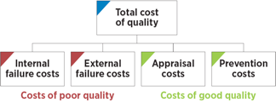
COST OF QUALITY (COQ)
— we know that quality is important, but it costs us time and money —
There is no question that quality has a cost, but lack of quality also has a cost
The real question is this: which cost should we be worried about?
Internal failure costs
External failure costs
Appraisal costs
Prevention costs

Slide 23
Internal failure costs
Internal failure costs are incurred to remedy defects discovered before the product or service is delivered to the customer.
These costs occur when the results of work fail to reach design quality standards and are detected before they are transferred to the customer.
They could include:
Waste: Performance of unnecessary work or result of errors, poor organization, or communication
Scrap: Defective product or material that cannot be repaired, used, or sold
Rework: Cost spend to correct the defective component or remove errors
Failure analysis: Activity required to establish the causes of internal product or service failure

Slide 24
External failure costs
External failure costs are incurred to remedy defects discovered by customers.
These costs occur when products or services that fail to reach design quality standards are not detected until after transfer to the customer.
They could include:
Repairs and servicing: Of both returned products and those in the field
Warranty claims: Failed products that are replaced or services that are re-performed under a guarantee
Complaints: All work and costs associated with handling and servicing customers’ complaints
Returns: Handling and investigation of rejected or recalled products, including transport costs

Slide 25
Appraisal costs
Appraisal costs are associated with measuring and monitoring activities related to quality.
These costs are associated with the suppliers’ and customers’ evaluation of purchased materials, processes, products, and services to ensure that they conform to specifications.
They could include:
Verification: Checking of process setup, and products against agreed specifications
Quality audits: Cost of testing and debugging
Supplier rating: Assessment and approval of suppliers of products and services
Cost of conducting technical reviews for software engineering work products
Cost of data collection and metrics evaluation (Chapter 23)

Slide 26
Prevention Costs
Prevention costs are incurred to prevent or avoid quality problems.
These costs are associated with the design, implementation, and maintenance of the quality management system.
They are planned and incurred before actual operation
They could include:
Product or service requirements: Establishment of specifications for incoming materials, processes, finished products, and services
Quality planning: Creation of plans for quality, reliability, operations, production, and inspection
Quality assurance: Creation and maintenance of the quality system
Training: Development, preparation, and maintenance of programs

Slide 27
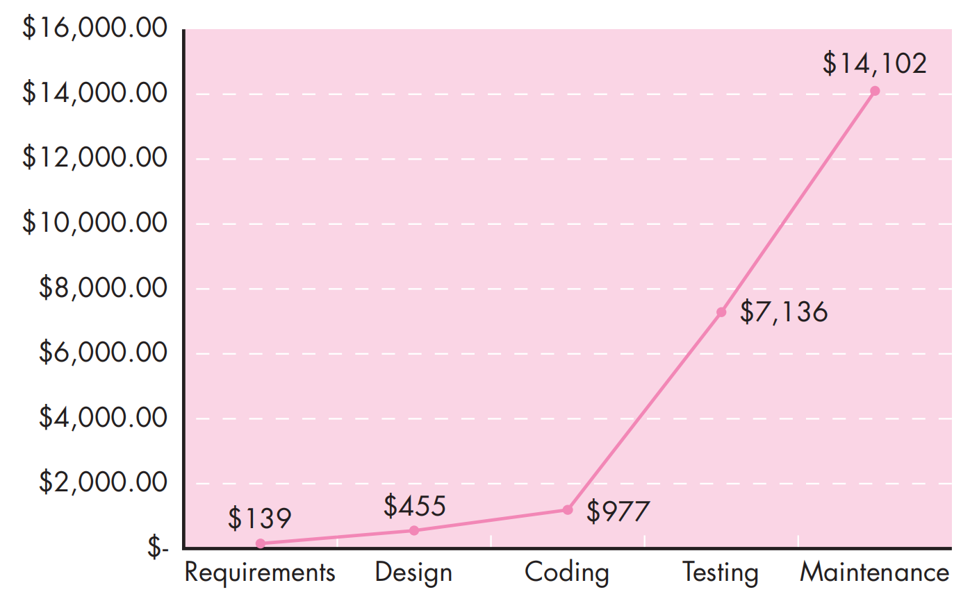
Relative cost of correcting errors and defects

Slide 28
Review Matrices

Slide 29
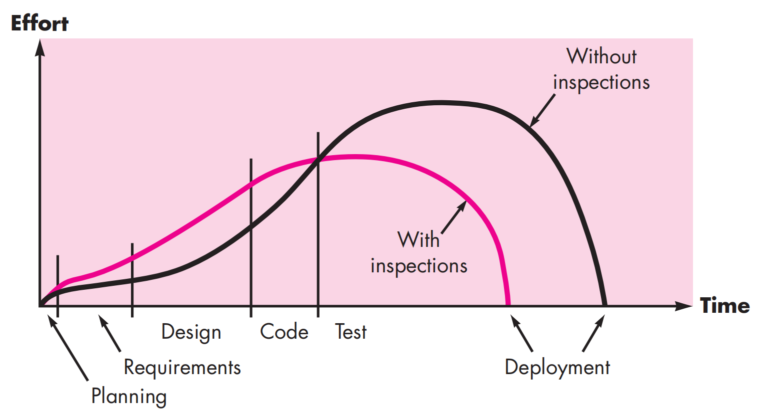
Effort expended with and without reviews

Slide 30
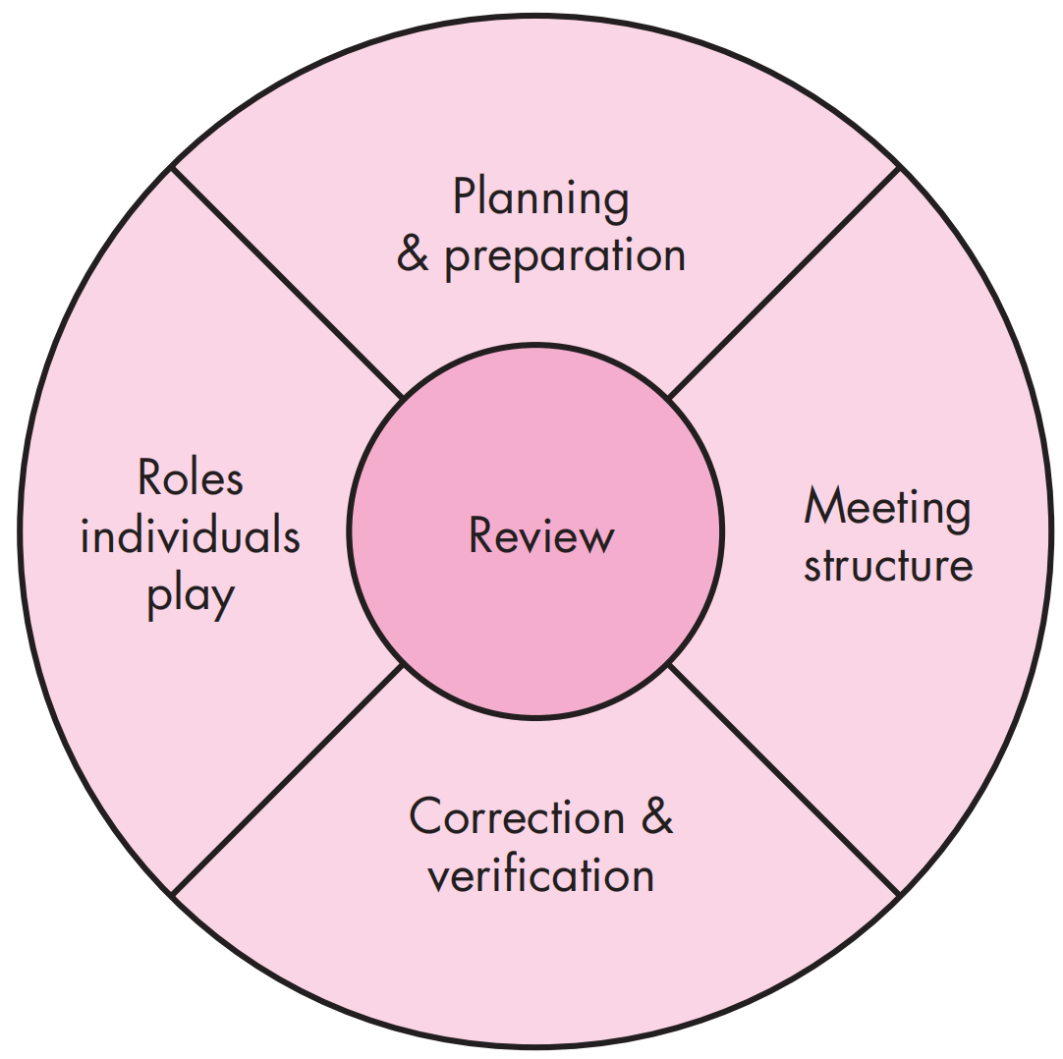
Reference model for technical reviews

Slide 31
INFORMAL REVIEWS
Informal reviews include a simple desk check of a software engineering work product with a colleague
A casual meeting (involving more than two people) for the purpose of reviewing a work product
One way to improve the efficacy of a desk check review is to develop a set of simple review checklists

Slide 32
FORMAL REVIEWS
A formal technical review (FTR) is a software quality control activity performed by software engineers (and others).
The objectives of an FTR are:
to uncover errors in function, logic, or implementation for any representation of the software;
to verify that the software under review meets its requirements;
to ensure that the software has been represented according to predefined standards;
to achieve software that is developed in a uniform manner;
to make projects more manageable

Slide 33
Review Guidelines
Review the product, not the producer.
Set an agenda and maintain it.
Limit debate and rebuttal.
Highlight problem areas, but don’t attempt to solve every problem noted.
Take written notes.
Limit the number of participants and insist upon advance preparation.
Develop a checklist for each product that is likely to be reviewed.
Allocate resources and schedule time for FTRs.
Conduct meaningful training for all reviewers.
Review your early review

Slide 34

Thanks for your attention!
Any Question?

